Slide 1

Use Case for RDMO at ULB and TU Darmstadt
NFDI AAI Workshop March 7th, 2023
David Wallace david.wallace@tu-darmstadt.de

Slide 2
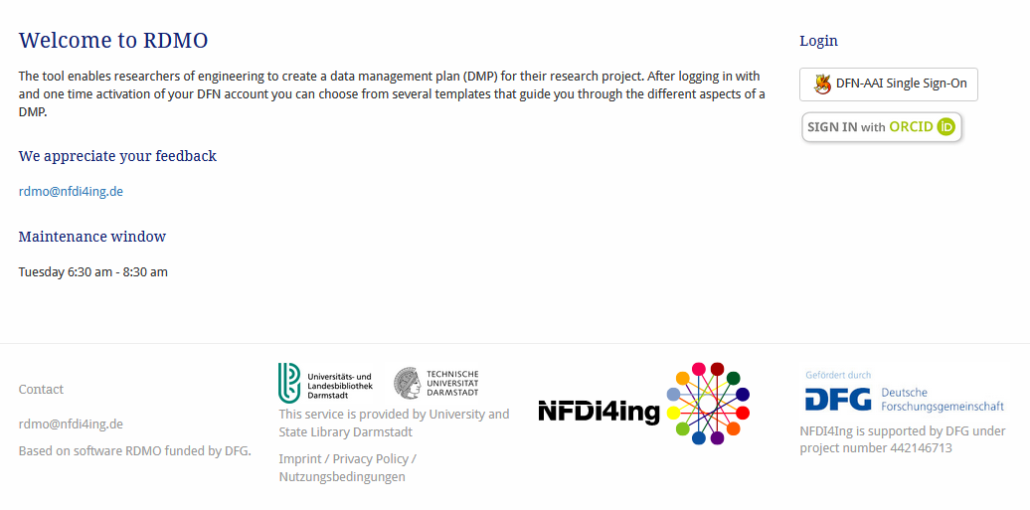
Use Case for RDMO at ULB and TU Darmstadt rdmo.nfdi4ing.de

Slide 3
Use Case for RDMO at ULB and TU Darmstadt rdmo.nfdi4ing.de
Authentication

Slide 4
Requirements for the service
Challenge: to support both SAML and OIDC based Authorization.
Authentication:
  simple login for all potential users (Single Sign-On, no registration etc.)
    German Institutional login, DFN-AAI Identity Providers (SAML)
    “external users” via ORCID or other social account providers (OIDC)
Authorization:
  user permissions are managed internally of the RDMO Service
    Authenticated Users create their own Projects, can invite other Users to join those Projects.
    Certain authenticated users are given elevated permissions by RDMO admins.
      Alternatively, manageable via a VO, shared with other services.

Slide 5

RDMO Service: Functional overview
Open Source Software Project: rdmorganiser.github.io
  Authorization:
  Users
    Researchers, RDManagers for collaborative projects
    create a data management plan (DMP) for their research project
    Choose a curated question catalog
  Project Managers, Content Editors
    Research data managers, technical data consultants, data stewards
    Create and manage hierarchical DMP projects, review DMPs
    Create and edit question catalogs in the content management system (CMS) web UI
  Admins
    Access to all content via web UI

Slide 6
RDMO Service: Technical overview
Open Source Software Project: rdmorganiser.github.io
  Overview of technical stack on web server:
      Backend:
        Python, Django, REST API
      Frontend:
        AngularJS (under development with React)
      Deployment at ULB:
        LAMP Server: Linux, Apache, MySQL and Python

Slide 7
Implementations of Authentication
Three main implementations for RDMO which are mutually exclusive [1]
  Installing a Shibboleth service provider (SP) next to RDMO and connect to an identity provider or even a whole Shibboleth federation. (SAML)
  Regular user accounts with registration using the django-allauth library, can be extended with OAuth2 and OpenID Connect Providers. (OIDC)
  Using a (read-only) connection to a LDAP server
    currently, not in our scope of interest
Unfortunately, these are considered as mutually exclusive at the moment.
[1] rdmo.readthedocs.io/en/latest/configuration/authentication/index.html

Slide 8
Implementations of Authentication
Shibboleth, institutional login
Technical stack for RDMO [2]:
shibboleth SP / apache2 vhost / django-shibboleth-remoteuser
Requirements:
  ✅ SAML: DFN-AAI Discovery Service
  ❎ OIDC: not possible because of vhost configuration
Possible solutions:
  One Identify Provider that supports both:
    Does it currently exist and who will provide this IdP?
[2] rdmo.readthedocs.io/en/latest/configuration/authentication/shibboleth.html#shibboleth

Slide 9
Implementations of Authentication
django-allauth, social login
Technical stack for RDMO [3]:
django-allauth / add supported providers
Requirements:
  ❎ SAML: protocol not supported by django-allauth
  ✅ OIDC: social Idproviders can be added
Possible solutions:
  Add an OIDC Provider that supports or mediates the DFN-AAI Discovery Service
    This solution was implemented in the ULB
[3] https://rdmo.readthedocs.io/en/latest/configuration/authentication/allauth.html

Slide 10

Current solution: Keycloak and SaToSa
Proxy
SP
IdP
Provides an IAM for different services of the ULB, supports both SAML & OIDC
Keycloak
  Open Source Identity and Access Management Software
  Lots of features and configuration:
    federation, user management, fine-grained authorization
    ✅ Supports: SAML & OIDC IdPs
  Deployed with Docker, serves a web interface to URL
  ❎ However, the Discovery Service (wayf) could not be implemented

Slide 11
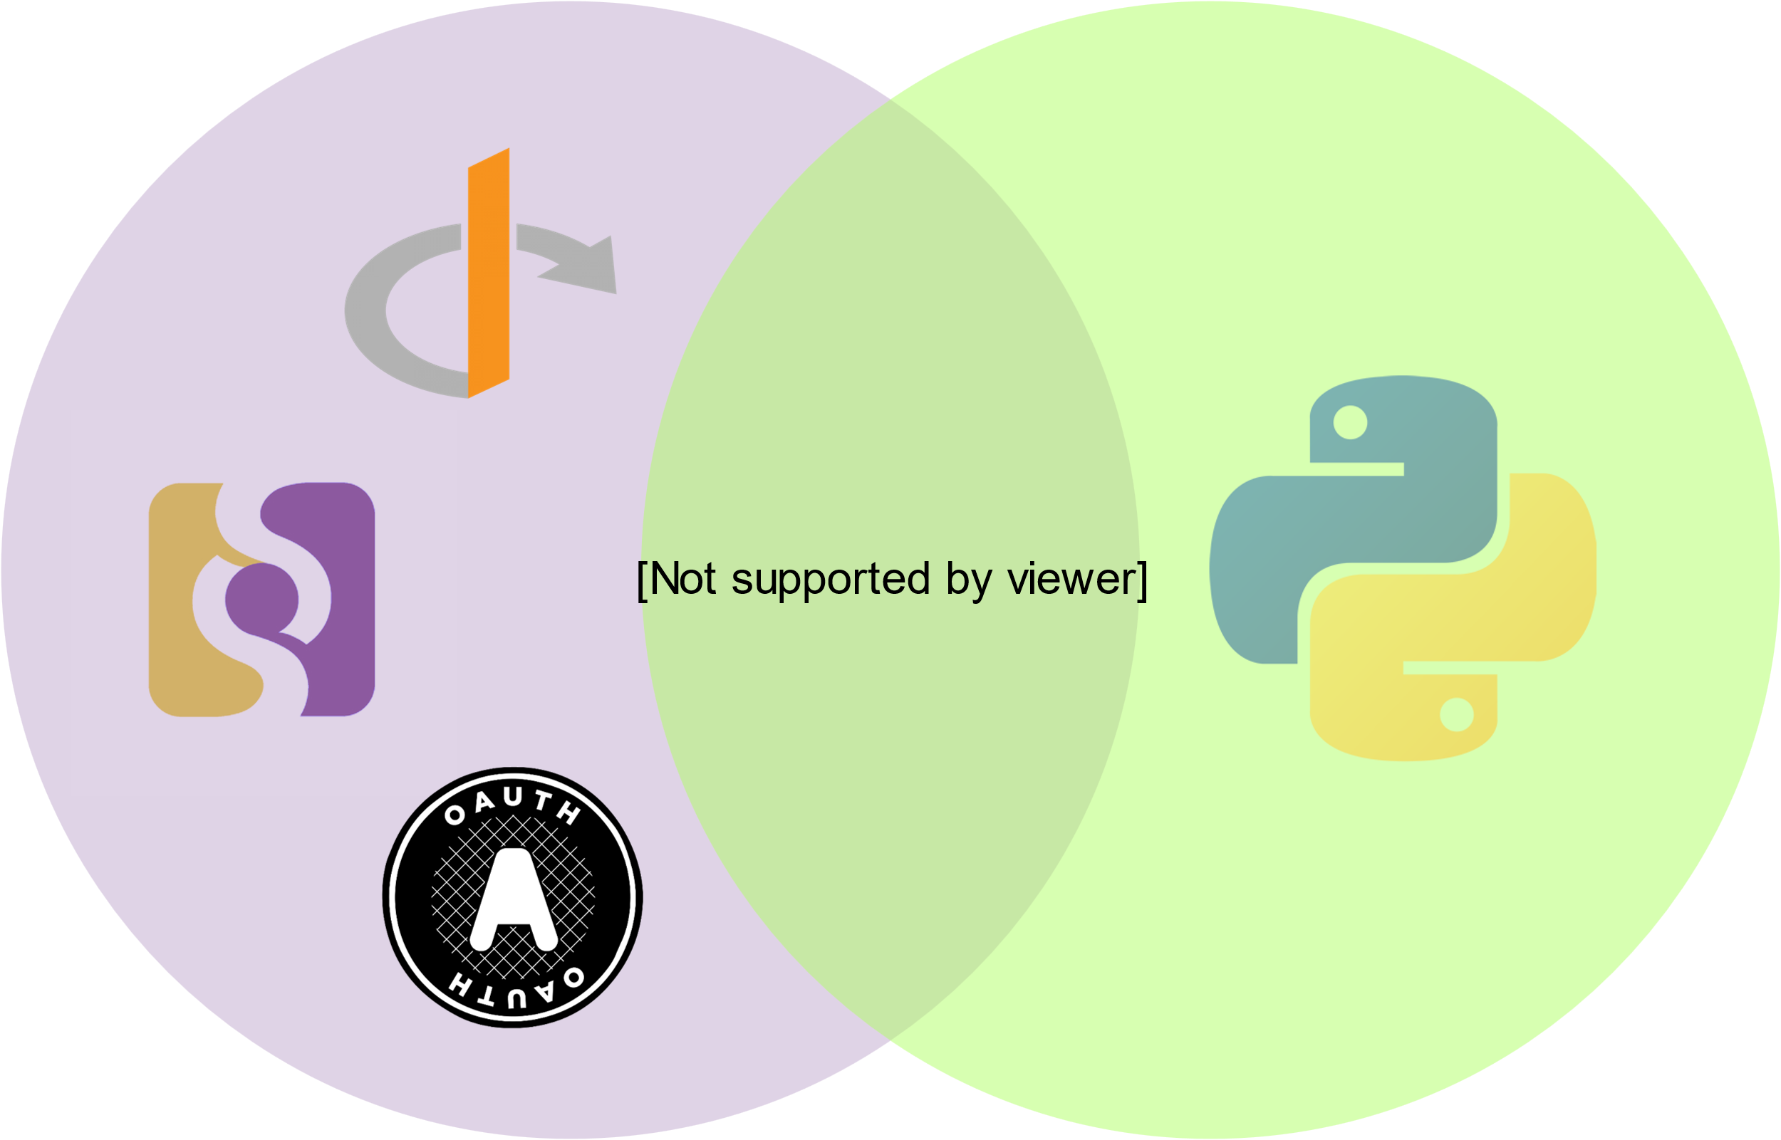
Current solution: Keycloak and SaToSa
Proxy
SP
IdP
Provides an IAM for different services of the ULB, supports both SAML & OIDC
  SaToSa[4]
  Proxy translating between different authentication protocols
  SAML < - > SAML
    Single Service Provider < - > Multiple Identity providers
    ✅ Supports the Discovery Service
  Attribute mapping in configuration
    saml (pairwise-id or EduPPN), oidc (sub), orcid
  ✅ Setup and registered as a DFN-AAI shibboleth SP (SAML)
  ✅ In Keycloak installed as a “IdP” (OIDC)
  Embedded Discovery Service
    a costum landing page for the Discovery Service was developed in go
[4] The Identity Python

Slide 12
Current solution: Keycloak and SaToSa
Overview of local authentication infrastrucure
DFN-AAI
Discovery Service
SaToSa
Proxy
Keycloak
IdP / SP
SAML
IdP / SP
SAML
IdP / SP
OIDC

Slide 13

Current solution: Keycloak and SaToSa
Overview of local authentication infrastructure, ORCID addition
DFN-AAI
Discovery Service
SaToSa
Proxy
Keycloak
IdP / SP
SAML
IdP / SP
SAML
IdP / SP
OIDC
IdP / SP
OIDC
IdP / SP
OIDC

Slide 14
Current solution: Keycloak and SaToSa
Overview of local authentication infrastructure, other AAI proxies
DFN-AAI
Discovery Service
SaToSa
Proxy
Keycloak
IdP / SP
SAML
IdP / SP
SAML
IdP / SP
OIDC
local IDM at ULB for multiple services.
For RDMO it could be replaced with other AAI proxies

Slide 15
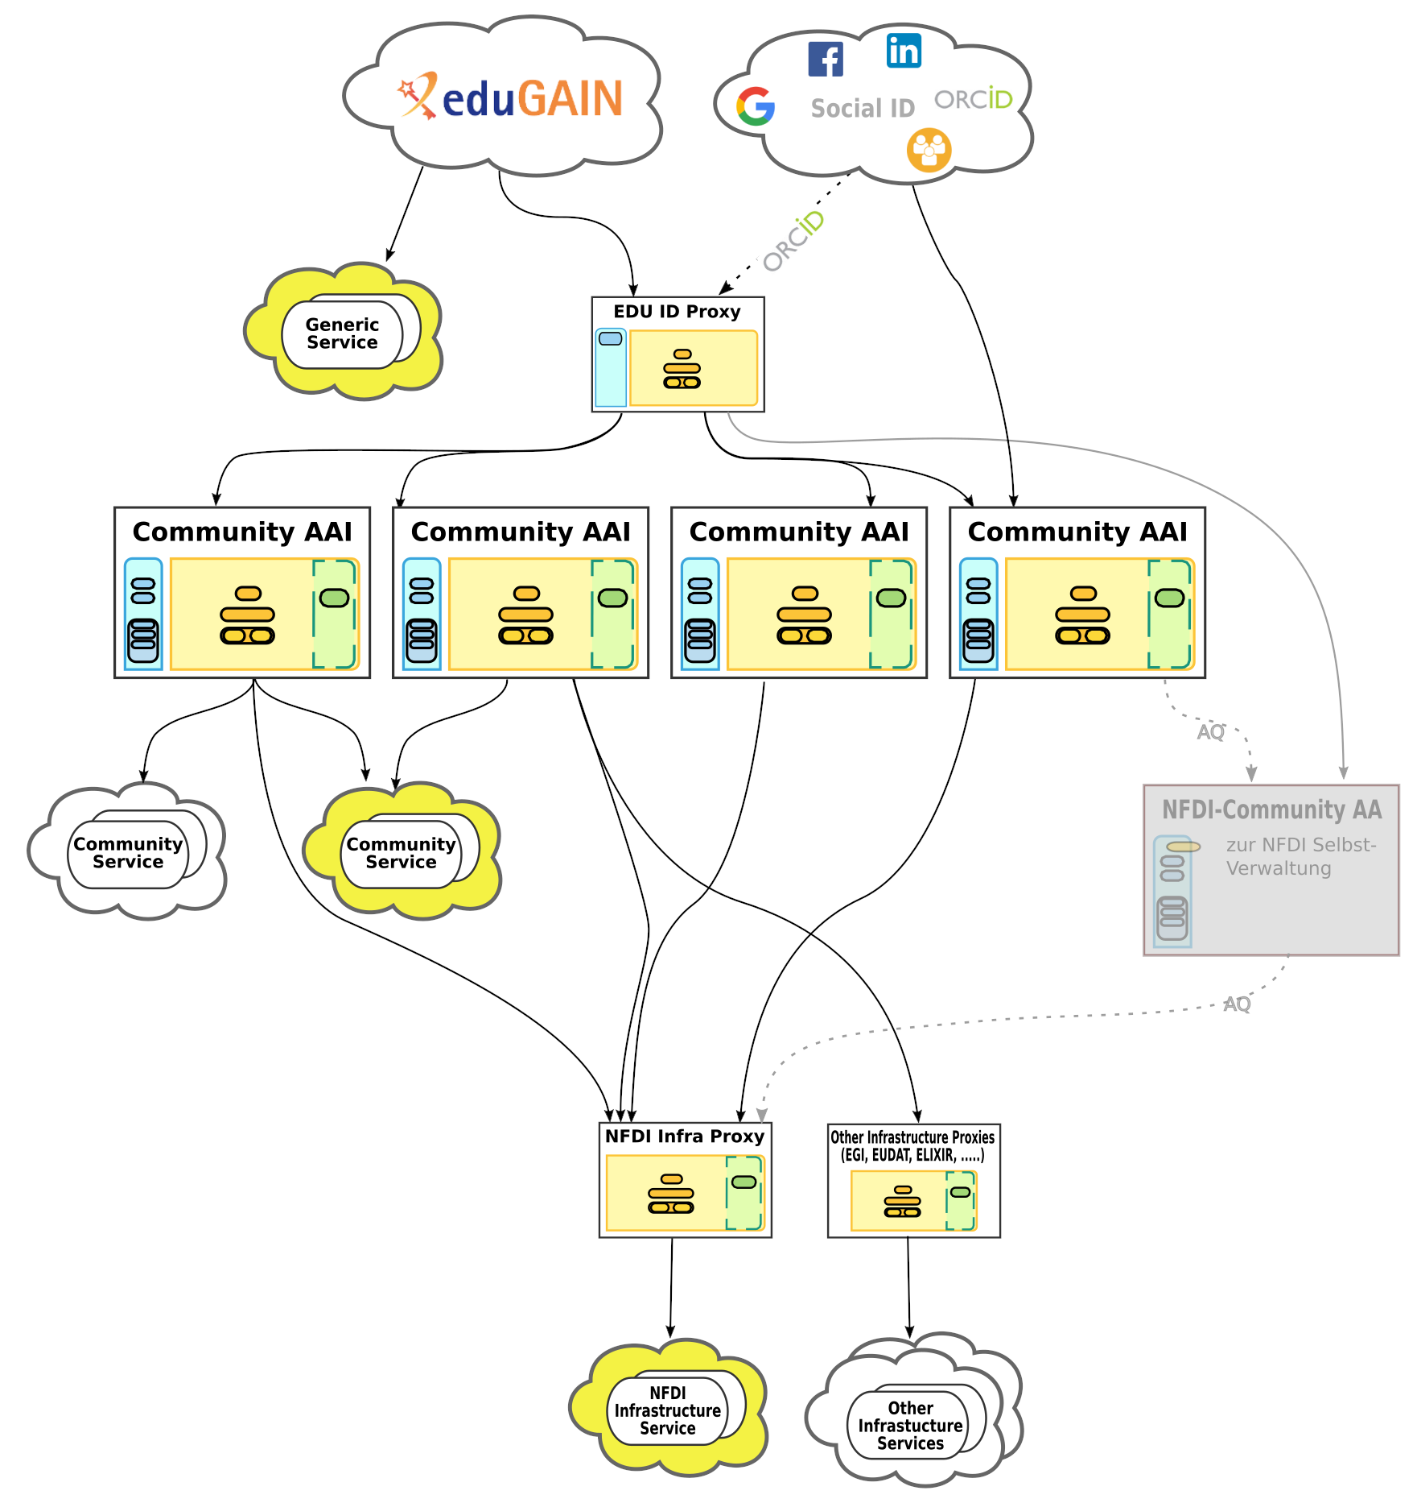
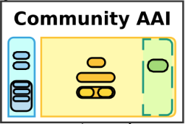
Solution: „Community AAI“ or „Infrastructure Proxy“
Outlook: implement authentication to a Community AAI with SAML or OIDC
A NFDI Community AAI would support both protocols. This would make implementation in RDMO straightforward.
The service provider can choose the protocol based on certain requirements or technical considerations.
Looking forward to authentication via a Community AAI!
https://doc.nfdi-aai.de
IdP / SP
SAML
IdP / SP
OIDC

Slide 16
Thanks! Questions? Comments?
David Wallace
Forschungsdaten-Service
ULB Darmstadt david.wallace@tu-darmstadt.de

Slide 17
Extra Slide: Keycloak and SaToSa
Proxy
SP
IdP
A Proxy that translates between SAML (as SP) and OICD (as IdP)
Currently at the ULB, we have implemented this solution for RDMO [4] and other services
SP: the DFN-AAI Discovery Service (wayf) was installed and provides translation of protocols. (SaToSa)
IdP: a Keycloak Instance, between the SP and RDMO
  provides the redirection to the proxy and transfer of the OpenID Connect JSON Web Token (JWT).
RDMO: uses django-allauth and adds the providers.
  Keycloak as “DFN-AAI” Provider
  ORCID
[4] rdmo.readthedocs.io/en/latest/configuration/authentication/shibboleth.html#alternative-to-shibboleth-keycloak-and-satosa

Slide 18
Extra Slide: Keycloak and Satosa
Proxy
SP
IdP
The SaToSa Proxy as shibboleth SP
Technical overview
SP: the DFN-AAI Discovery Service (WAYF) with SaToSa
  Embedded Discovery Service: a costum landing page for the Discovery Service was developed in go
  EntityID, FQDN, Metadata, Attributes
    Federation: need to request registration of our SP at the IdPs
  Attributes: pairwise-id
      eduPPN also supported, when IdP does not deliver pairwise-id
    givenName, sn und mail
    Mapping between Attributes of saml, openid and orcid

